Slide 1

STEM Student Scholars Program (3SP)
Information Session #2
May 10, 2017
Presented by:
Joseph M. Sivo
Bergen Community College

Slide 2

STEM Student Scholars Program (3SP)
Information Session #2
May 10, 2017
Presented by:
Joseph M. Sivo
Bergen Community College

Slide 3
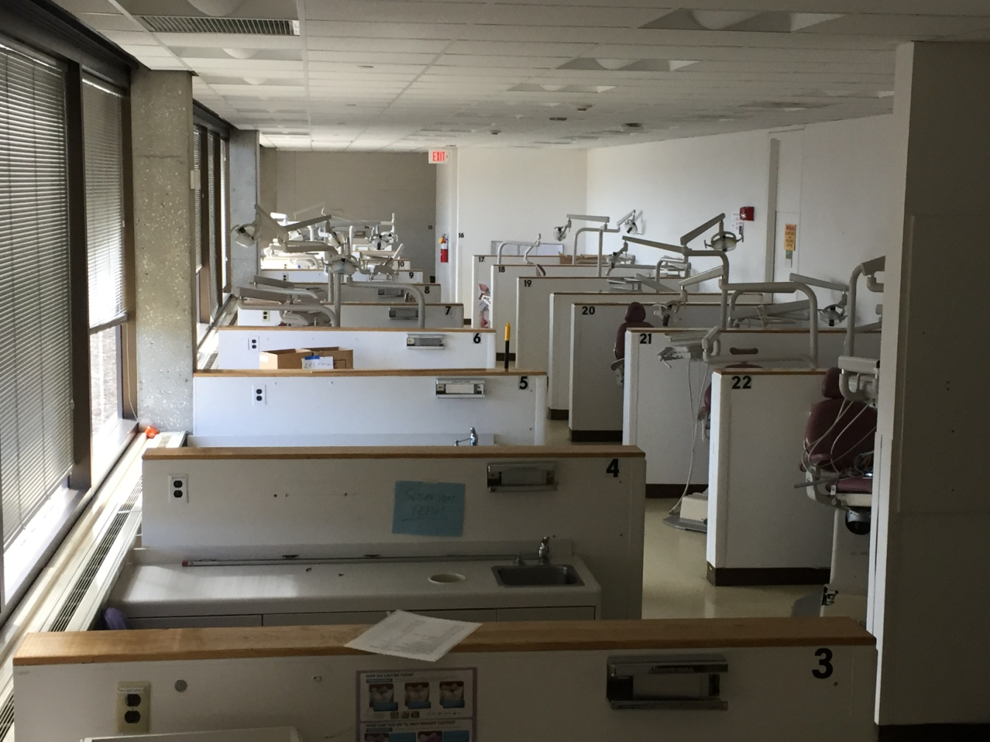
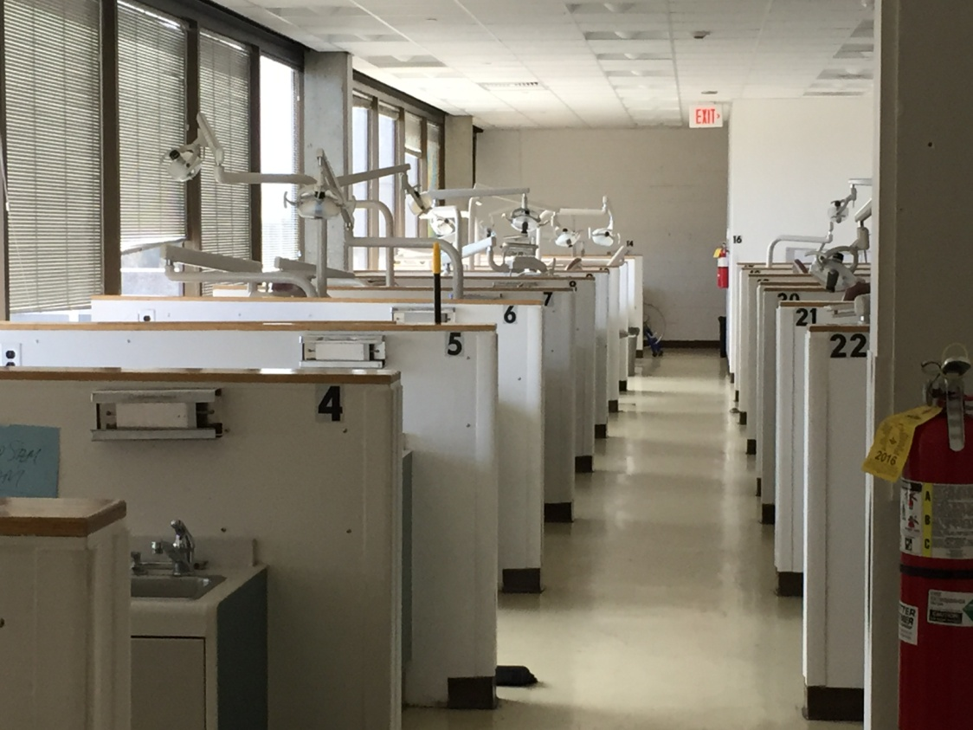
STEM Student Scholars Program (3SP)
Information Session #2
May 10, 2017
Presented by:
Joseph M. Sivo
Bergen Community College

Slide 4
STEM Video
https://www.youtube.com/watch?v=oMRm7NDIpmY
by: STEM Student Cassie Gilbert

Slide 5
KSA Learning
Knowledge - Understanding principles related to a
particular subject.
Skills - How to use something or perform a particular
task.
Ability - A competence to perform a set of
behaviors that results in an observable product.

Slide 6
STEM Student Scholars Program (3SP)
Purpose:
The STEM Student Scholars Program shall promote excellence
in knowledge, skills and ability of a select group of STEM students
to ensure their success in securing research internships and successful
transfer to their targeted 4-year institution.
Program elements:
Academic elements
Research elements
Service elements
Benefits:
Students who successfully complete the program and obtain an associate degree shall have their achievement recorded on their official transcript
Students who successfully participate in the program shall have an opportunity in their second summer in the program to participate in an internship off campus in their target 4-year college or industry

Slide 7
STEM Student Scholars Program (3SP)
Who to solicit?
3.40 Cumulative GPA: 548 Students
3.50 Cumulative GPA: 451 Students
3.70 Cumulative GPA: 295 Students
3.75 Cumulative GPA: 242 Students

Slide 8
STEM Student Scholars Program (3SP) Requirements
Eligibility Requirements for e-mail notification
STEM degree seeking
Finished 12 college level credits
with no additional remediation required
3) Minimum 3.750 Cumulative GPA
Admission Requirements
Attended one information session
2) Maintained minimum 3.750 Cumulative GPA
at end of Spring 2017 semester
Completed and submitted a 3SP application
Joined a 3SP Faculty Research Mentor’s project team for Summer I
or Summer II internship
5) Will remain a Bergen student through the fall 2017 semester
Ongoing Requirements to remain in good standing
Successfully completed an on campus 3SP Summer I or Summer II internship
Working to complete 3SP Academic, Research and Service Requirements
Contributing member of the STEM Student Union club
Maintaining minimum 3.750 Cumulative GPA
Punctual and responsive to official 3SP communications

Slide 9
Management of 3SP
The program will be administered by a paid program coordinator (3SP Faculty Chair)
working in conjunction with a team (cadre) of 3SP Faculty Research Mentors who shall meet on a monthly basis for the following purposes:
To review admission applications into the program
To review the progress of individual students in the program and decide on censure and/or removal of students
To ensure that research internships on-campus are secured in the first summer of the students membership in the program
To ensure that research internships at a 4-year college or industry are secured in the second summer
All faculty involved in mentoring research projects as part of the program must participate in these monthly meetings.

Slide 10
3SP Timetable
1) Solicitation to 242 students with minimum GPA of 3.750 to become 3SP scholars sent out
Friday, March 31. Deadline: Friday, April 7, 2017 at 11:59 PM EST.
Responses: 66
2) Solicitation to STEM faculty to become 3SP Faculty Research Mentors sent out April 3.
Deadline: Wednesday, April 19, 2017 at 11:59 PM EST.
Responses: 25
3) First Information Session: Friday, April 28, 2017 at 6:00 PM in C-313
4) Second Information Session: Thursday, May 4, 2017 at 12:30 PM in C-313 (Canceled: bomb scare)
Wednesday, May 10, 2017 at 12:30 PM in C-313
5) Students of First Information Session fill out application form. Deadline: Thursday May 11 at 5 PM
Students of Second Information Session fill out application form. Deadline: Monday May 15 at Noon
Faculty fill out project proposal form. Deadline: Tuesday May 16 at 5 PM
6) First cohort of internships: Summer I, Monday May 22
7) Second cohort of internships: Summer II, Wed July 5
8) 3SP Induction Ceremony: Fall 2017 - TBA

Slide 11
STEM Student Scholars Program (3SP)
Purpose:
The STEM Student Scholars Program shall promote excellence
in knowledge, skills and ability of a select group of STEM students
to ensure their success in securing research internships and successful
transfer to their targeted 4-year institution.
Program elements:
Academic elements
Research elements
Service elements
Benefits:
Students who successfully complete the program and obtain an associate degree shall have their achievement recorded on their official transcript
Students who successfully participate in the program shall have an opportunity in their second summer in the program to participate in an internship off campus in their target 4-year college or industry

Slide 12
3SP Program Elements
Academic elements - Students of the program must complete one mini-course from each of the following three categories*:
1) Software:
SOLIDWORKS
PTC Creo
LabVIEW
MATLAB and SIMULINK
2) Equipment Use and Instrumentation:
3-D Printing
Machining (including basic tool use, welding and plasma cutting)
3) Communication and Writing:
Speech Coaching
Project Planning and Budgeting
Writing a Business Plan
Technical Writing in the CSE format
* Many additional mini-courses will be added in other fields

Slide 13
3SP Program Elements
Research elements - Students of the program must participate in:
On-campus faculty-mentored internship project in their first summer of the program.
Off-campus internship project in their second summer of the program.
The student shall contribute a minimum of 2 hours per week working on a project during the fall and spring semesters
The student shall become a contributing member of the STEM Student Union club
Additional Research elements (determined by 3SP Faculty Research Mentors):
co-author with team members a weekly blog documenting project progress throughout Summer I or Summer II internships
co-author a professional quality poster of project for STEM C² Research Summit at Bergen Community College
Give presentations at various events and meetings both on-campus and off-campus

Slide 14
3SP Program Elements
Service elements - Students of the program must:
Serve as an academic mentor to a MAT-048 or MAT-160 student. This includes regular weekly mentoring sessions
Give presentation at one off-campus science fair or conduct a STEM demonstration/workshop session at an off-campus educational institution in the area

Slide 15
3SP Membership Application

Slide 16
Meet the 3SP Faculty Research Mentors!

Slide 17
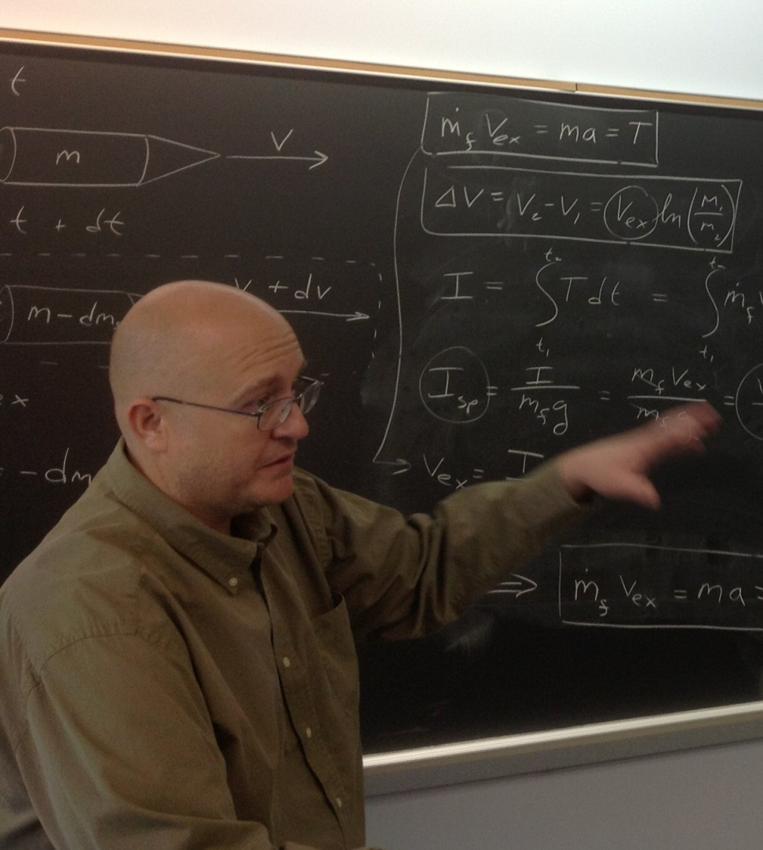
3SP Information Session Spring 2017
Dr. Joseph Michael Sivo
Professor of Physics
Office: S-325
E-mail: jsivo@bergen.edu
Project topics of interest:
Engineering, Energy-related projects, Astronomy, Physics
Continuing Projects:
Thermal Energy Project (Heat transfer study of Blockhouse)
Meteor detection project (building antenna to detect meteors and UFOs!)
VEGETA (wind turbine testing platform)
Scaredrone™: (computer vision based
precision agricultural UAV drone design)
mini-Hybrid Rocket Engine and Test Stand Development
Pedal Power electricity demonstrator

Slide 18
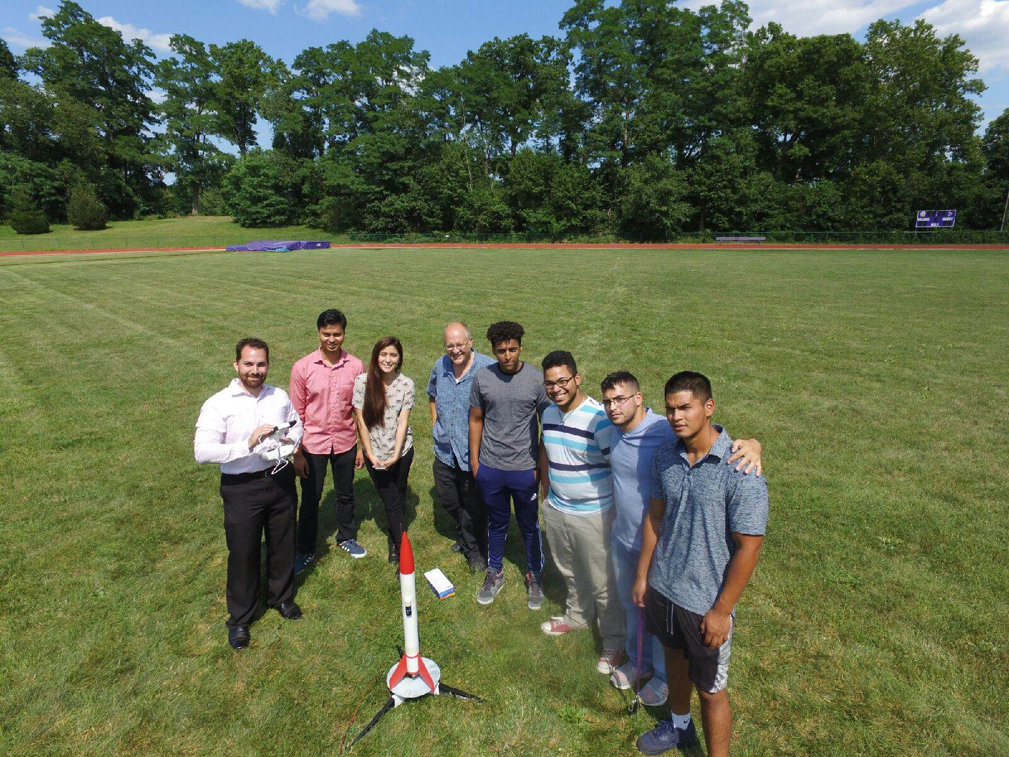
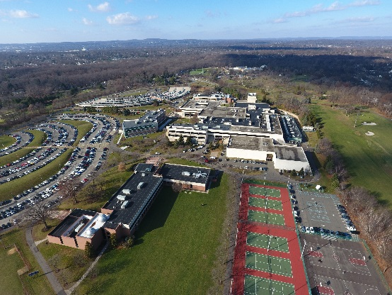
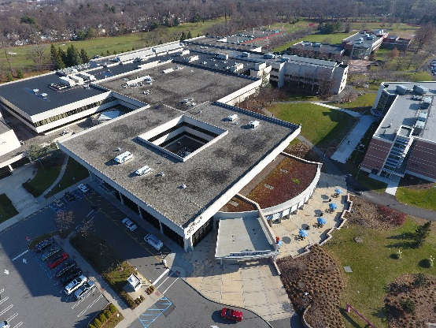
3SP Information Session Spring 2017
Luis De Abreu
STEMatics Grant Program Director
Office: L-131
E-mail: Ldeabreu@Bergen.edu
Project topics of interest:
Engineering
Unmanned Aerial Vehicles
Energy-related projects
Continuing Projects:
UAV – Unmanned Aerial Vehicles
Thermal Energy Project (project with Turning Point students)
Scaredrone: (computer vision based
precision agricultural UAV drone design)

Slide 19

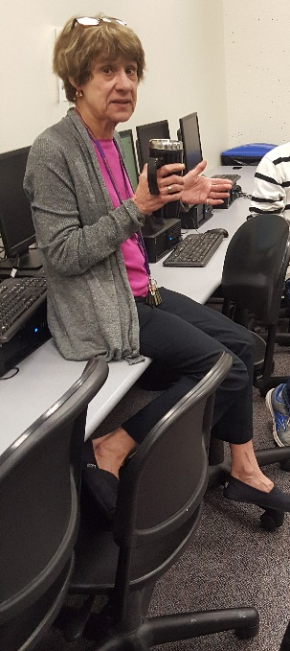
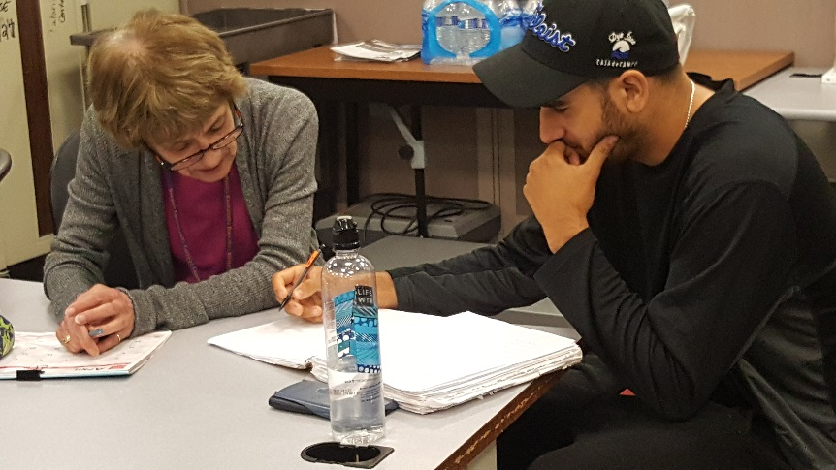
3SP Information Session Spring 2017
Ruth Feigenbaum, Ph.D
Professor of Mathematics
Office: B-111A
E-mail: rfeigenbaum@bergen.edu
Project topics of interest:
Math support for projects
Statistical analysis for data

Slide 20

3SP Information Session Spring 2017
Project topics of interest:
Why many of students are not interested in Math, How we can find the ways to make it attractive and fun.
Since my background is in art and math, I can compare research to a sea.
If you want to swim in the sea of research, you have to consider its rules. It is challenging until you prove your hypothesis. And when you get your result, you enjoy from the aesthetic aspects of this sea.
Research will never end, like the water in sea.
Dr. PanteA Bahrami
Professor of Math and German Language
Math: at Seton Hall University & Huntington Learning Center
German: at BCC
E-mail: bahrami.pantea@gmail.com

Slide 21
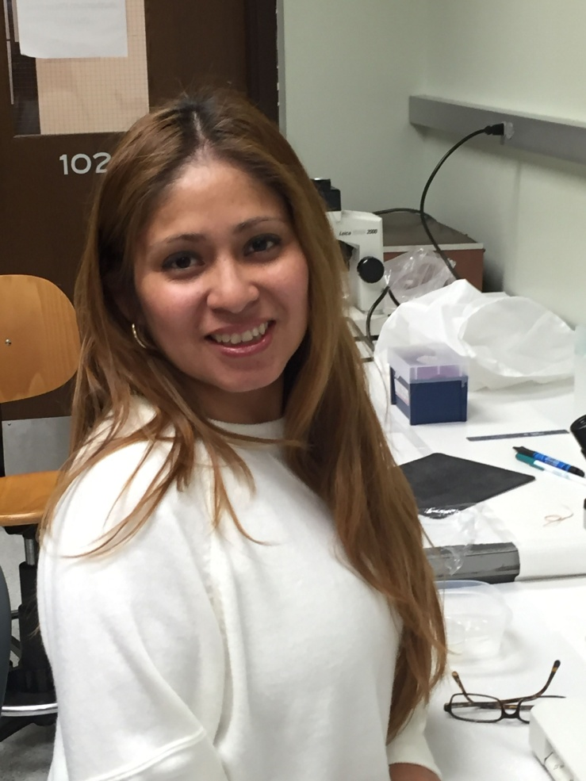
3SP Information Session Spring 2017
Dr. Maria Agapito
Adjunct Professor of Biology
Office: TBA
Email: magapito@bergen.edu
Project topic of interest:
Biology, developmental effects of
Environmental factors (Alcohol or
Bisphenol Analogues, and Metabolism
Continuing Projects:
Effects of Soy, Maca and Quinoa Extracts on Lipid Deposition

Slide 22
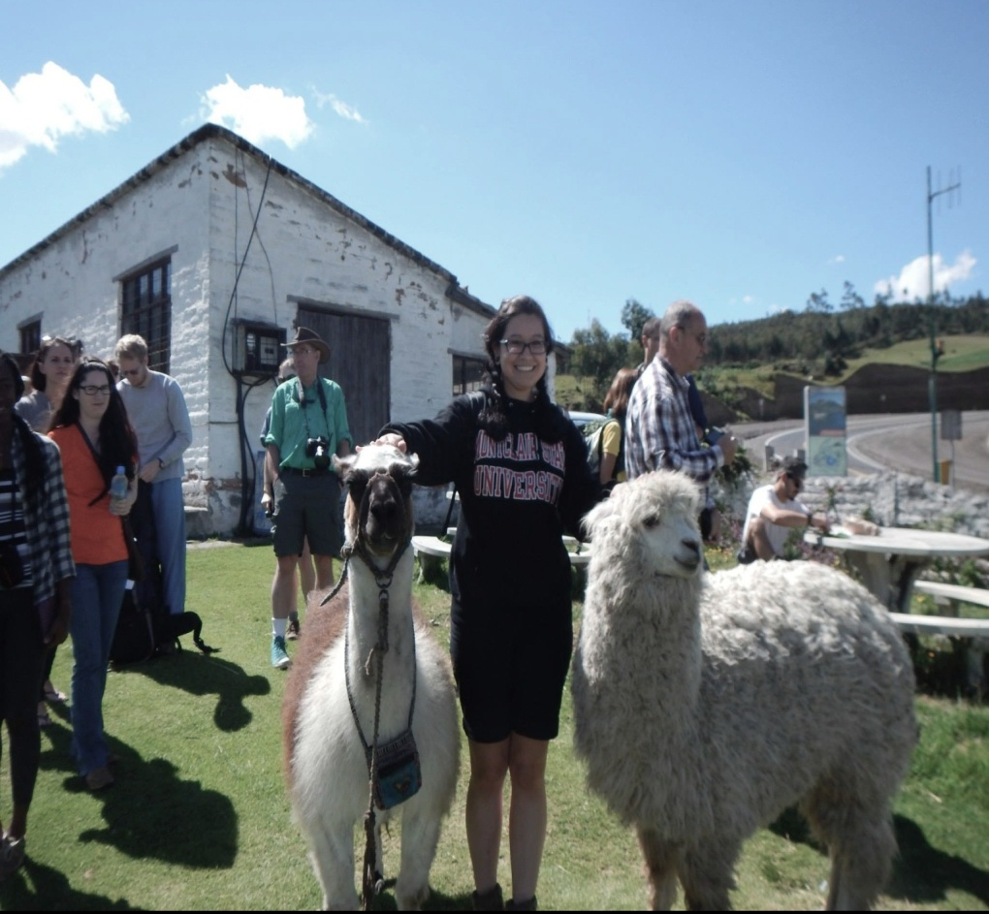
3SP Information Session Spring 2017
Linda V. Araya, MS
Adjunct Professor, Biology
STEM SI Coordinator
Office: L-131
E-mail: Laraya@bergen.edu
Project topics of interest:
Ecology, Evolutionary Biology, Sustainability, Animal Sciences
Continuing Projects:
Veggie Watt (reusing cooking oil to generate usable energy)

Slide 23
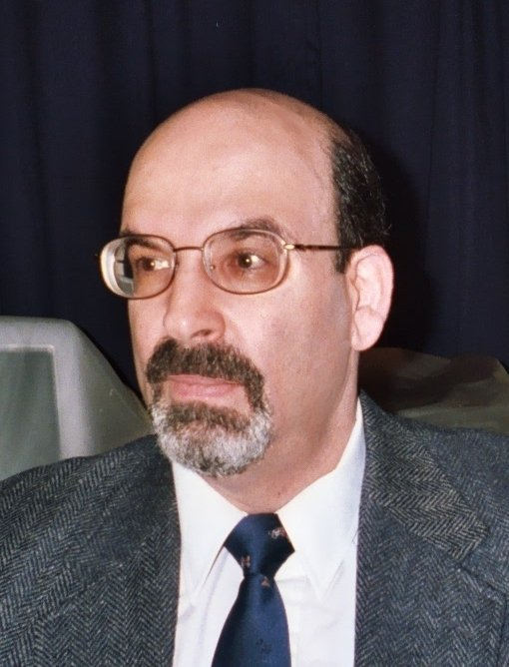
3SP Information Session Spring 2017
Dr. Bruce W. Benjamin
Adjunct Professor of Chemistry
Office: S-315
E-mail: bbenjamin@bergen.edu
Project topics of interest:
Robotics, Process Engineering, Numerical Methods, Simulation and Process Control, Chemistry
Continuing Projects:
VEX Robotics
Hydroponics

Slide 24
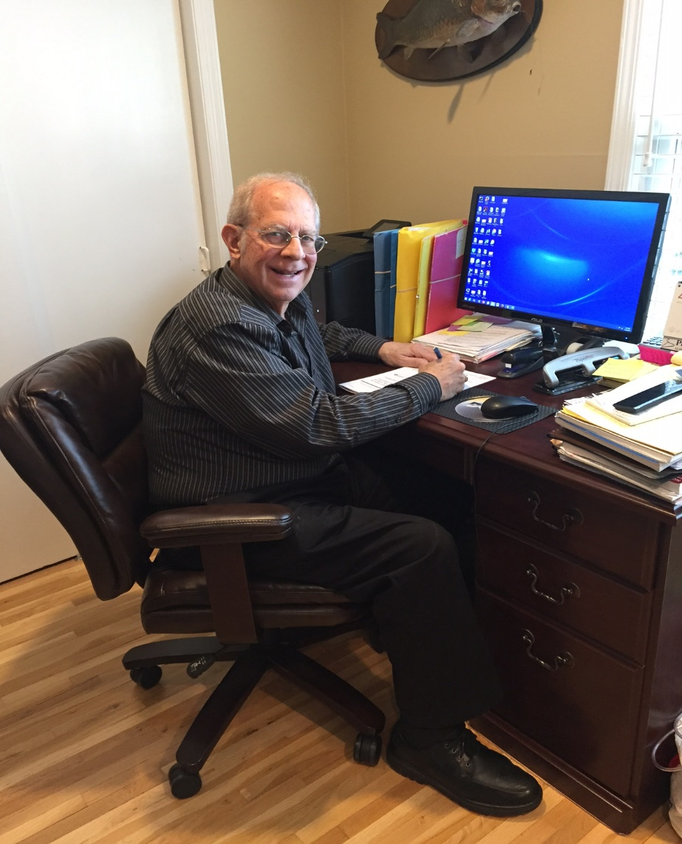
3SP Information Session Spring 2017
Alan Eliscu
Professor of Computer Science
E-mail: aeliscu@bergen.edu
Project topic of interest:
Enterprise Computing
Synopsis:
Mainframe technology is not becoming obsolete and there is great demand for people with programming, database design, database support, systems programming and security expertise in the IBM Z System technical space.
Individuals who can augment their client-server backgrounds with enterprise computing skills command salaries in excess of 20% greater than those without the skills.
Our first min-course will teach how to program mainframe applications.

Slide 25
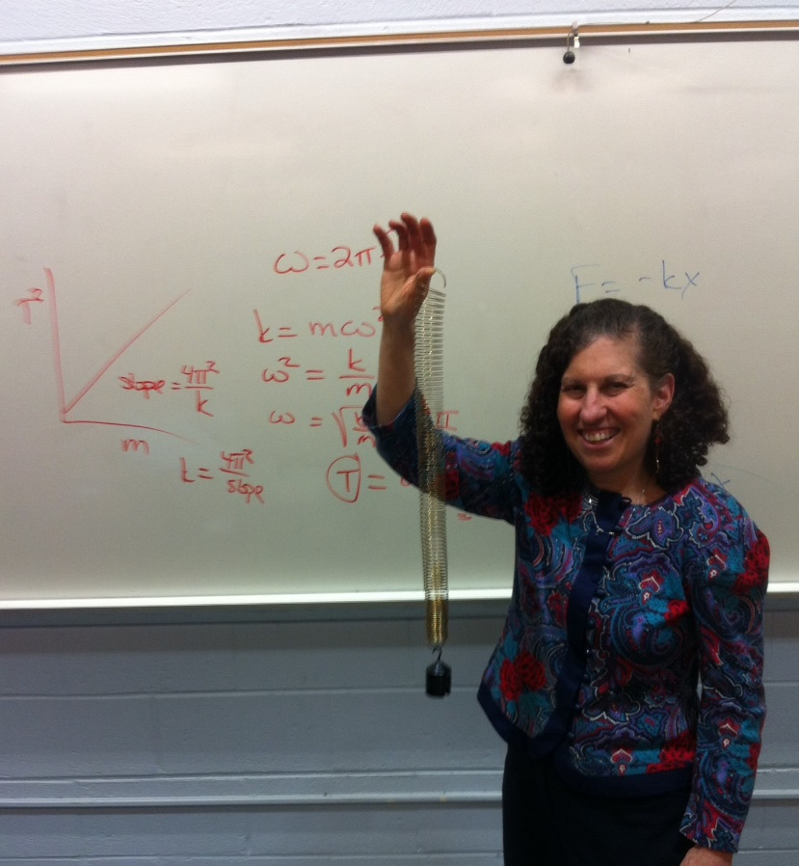
3SP Information Session Spring 2017
Dr. Estelle Kunoff Epstein
Adjunct Professor of Physics
Office: S-332
E-mail: eepstein@bergen.edu
Project topics of interest:
Solar Energy,

Slide 26
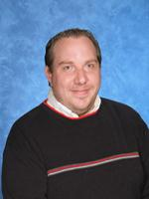
3SP Information Session Spring 2017
Mr. Brian M. Fuschetto
Adjunct Professor of Information Technology and Computer Science
E-mail: bfuschetto@bergen.edu
Project topics of interest:
Computer Science, Application Development, Programming, Computer Based Solutions to Problems
Continuing Projects:
Gender equity in Computer Science
Improving the image of Computer Science to college students as a potential major

Slide 27
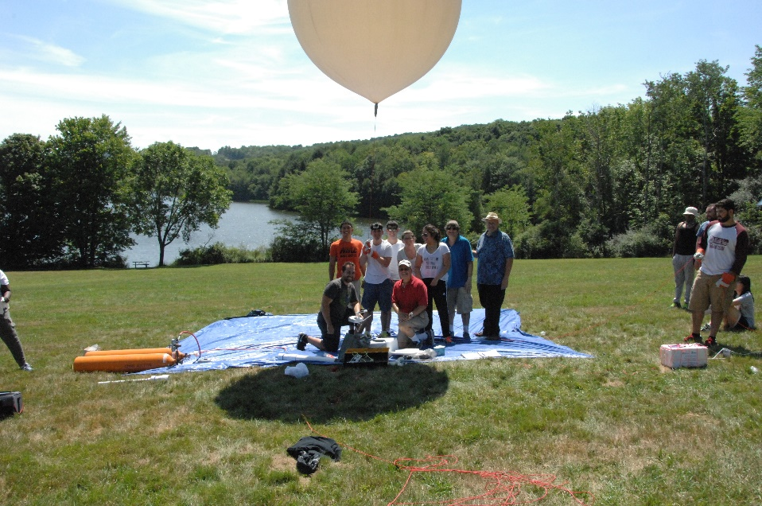
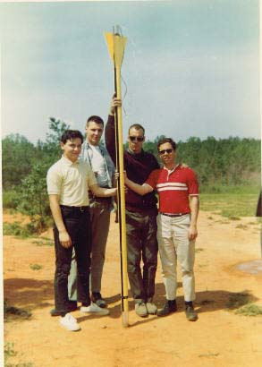
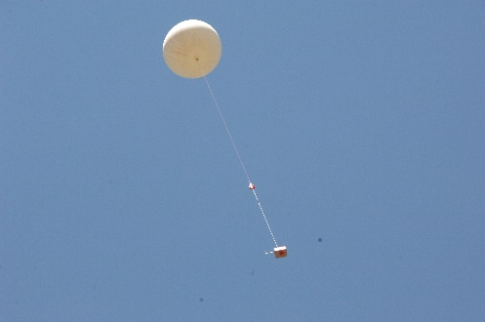
3SP Information Session Spring 2017
Paul J. Griffo
Professor of Physics
Office: C-114
E-mail: pgriffo@bergen.edu
Project topics of interest:
Aerospace – High Altitude Weather Balloon Project; High Powered Rocketry
Continuing Projects:
High Altitude Balloon – experiment design and integration; photography; data collection, reduction, analysis
High Powered Rockets – computer modeling and design; build and launch; flyable experiments; parachute recovery systems

Slide 28
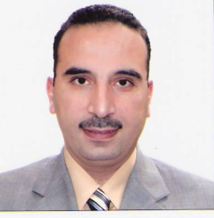
3SP Information Session Spring 2017
Dr. Mohamed Ibrahim
Professor of Biology
Office: C-107
E-mail: mmohamed106971@bergen.edu
Project topics of interest:
Molecular Microbiology, Biofuel projects, Bioactive apoptosis and Oxidative stresses
Continuing Projects:
Antibacterial ecofriendly nanoparticles
Isolation of anticancer bioactive compounds from medicinal plants.
Omics tools and their response under abiotic stresses.
Future projects
I encourage and welcome students of 3SP program to Join me and start together to investigate a scientific hypothesis concerning one of the hot scientific topics throughout the world.

Slide 29
3SP Information Session Spring 2017
Dr. Luis Jimenez
Associate Professor of Biology
Office: S-230
Laboratory:S-216
E-mail: ljimenez@bergen.edu
Project topics of interest: Environmental Biotechnology, Microbial Genetics, Microbial Ecology, Antimicrobial Research
Continuing Projects:
Genetic analysis of pathogenic genes
Cloning and characterization of microbial genes from soils
PCR analysis of microbial genes
Microbial fuel cells
Development of new molecular assays, RT-PCR, QPCR, to detect microorganisms in environmental samples
Antimicrobial activity of natural oils
2016
2017
2017

Slide 30
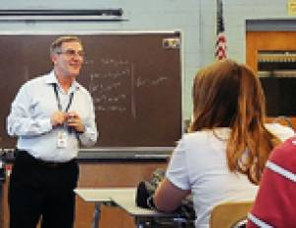
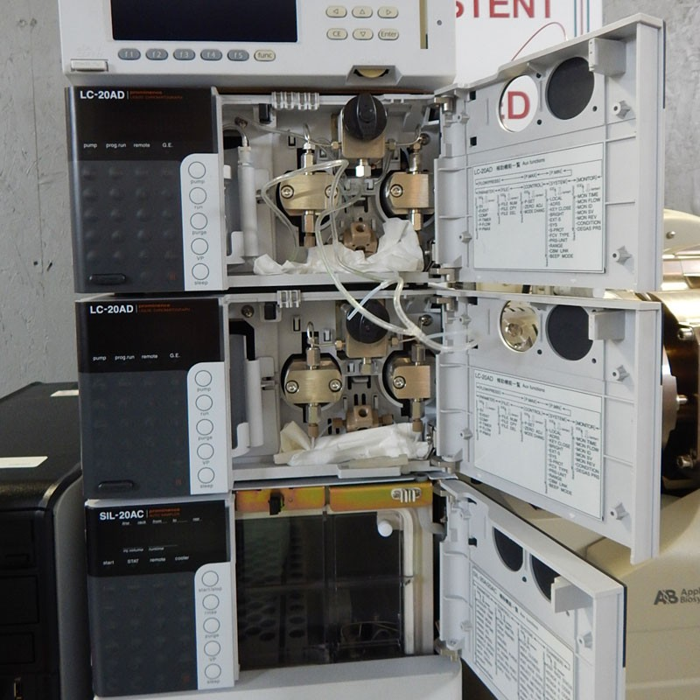
3SP Information Session Spring 2017
Dr. Ara N. Kahyaoglu
Associate Professor of Chemistry
Office: C-114
E-mail: akahyaoglu@bergen.edu
Project topics of interest:
Poison Ivy Cream, Organic Solar Cells, Biochemical Fuel Cells
Projects Highlights:
Binding of Catechol to the Skin Keratin
(Computer Modeling) / Developing a cream which can change color upon reaction with poison ivy
Oxidation of Glycerol with Immobilized Yeast, Oxidation Mechanism
ITO based Organic Fuel Cells Improved by Gold Nanoparticles

Slide 31
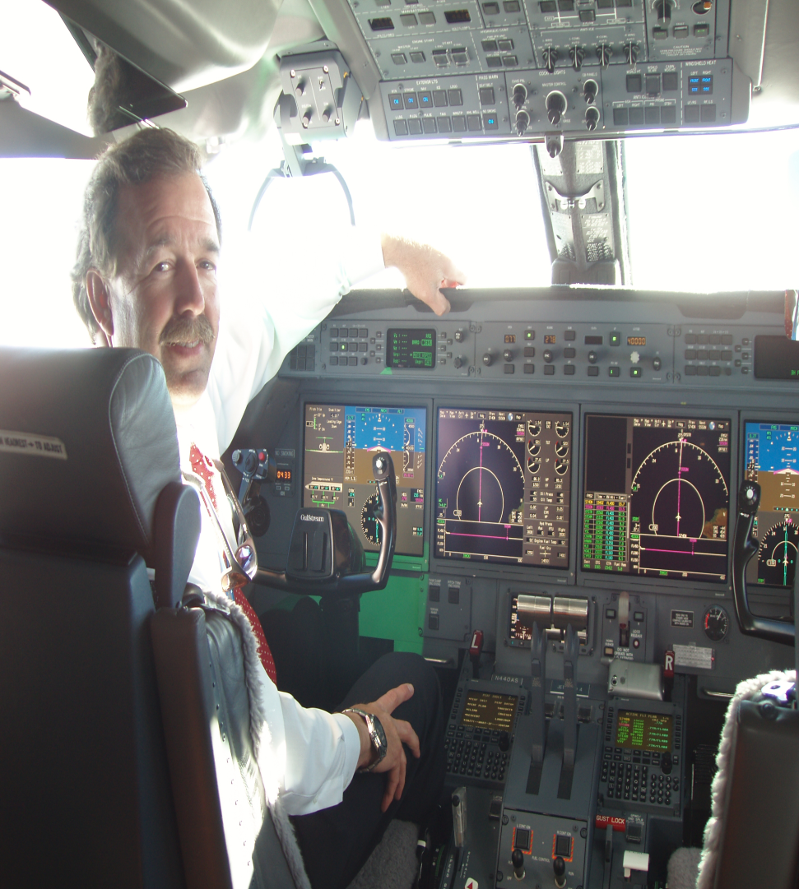
3SP Information Session Spring 2017
Bill Klappert
Airline Transport Pilot/CFII, G-550, G-450,
G-V, DA-2000, CL-601, NA- 265
Aviation
Office: TEC 105
E-mail: wklappert@bergen.edu
Project topics of interest:
Aviation
Air Traffic Control
Internships with large government and corporate entities.
Continuing Projects:
Internships :
Flight Safety International
Newark Liberty Tower
The Port Authority of NY & NJ
Career paths with United Airlines, Republic Airlines, Signature Flight Support.

Slide 32
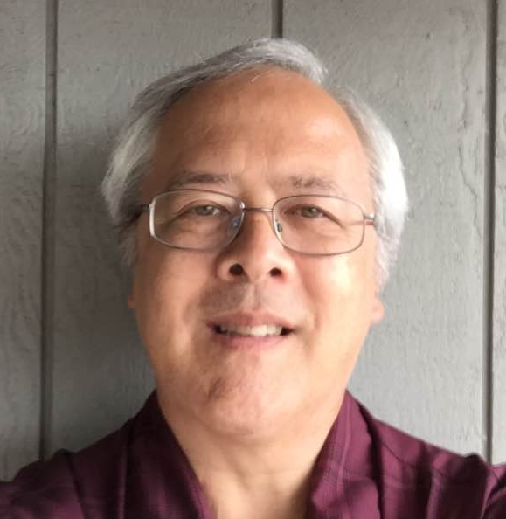
3SP Information Session Spring 2017
William Madden, Associate Professor
Information Technology
Office: C-117
E-mail: bmadden@bergen.edu
Project topics of interest:
Media Computing, 3D Printing, Astronomy, Optics
Continuing Projects:
Build 3D Printers
Audio Production

Slide 33
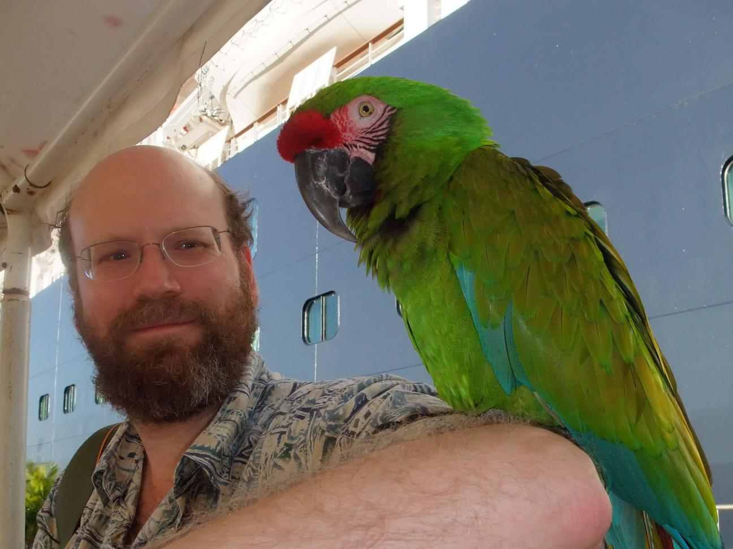
3SP Information Session Spring 2017
Dr. Fred Marton
Associate Professor of Geology and Physics
Office: S-325
E-mail: fmarton@bergen.edu
Project topics of interest:
Earth Science, Planetary Science, Physics
On-going SeismoSTEM Projects:
Calibrate TC-1 and AS-1 seismometers
Solar-powered shed
New SeismoSTEM Projects?
Horizontal or 3-axis seismometers
Solid-state seismometers
Seismic wave travel time calculator
Dr. Marton (left) and friend.

Slide 34
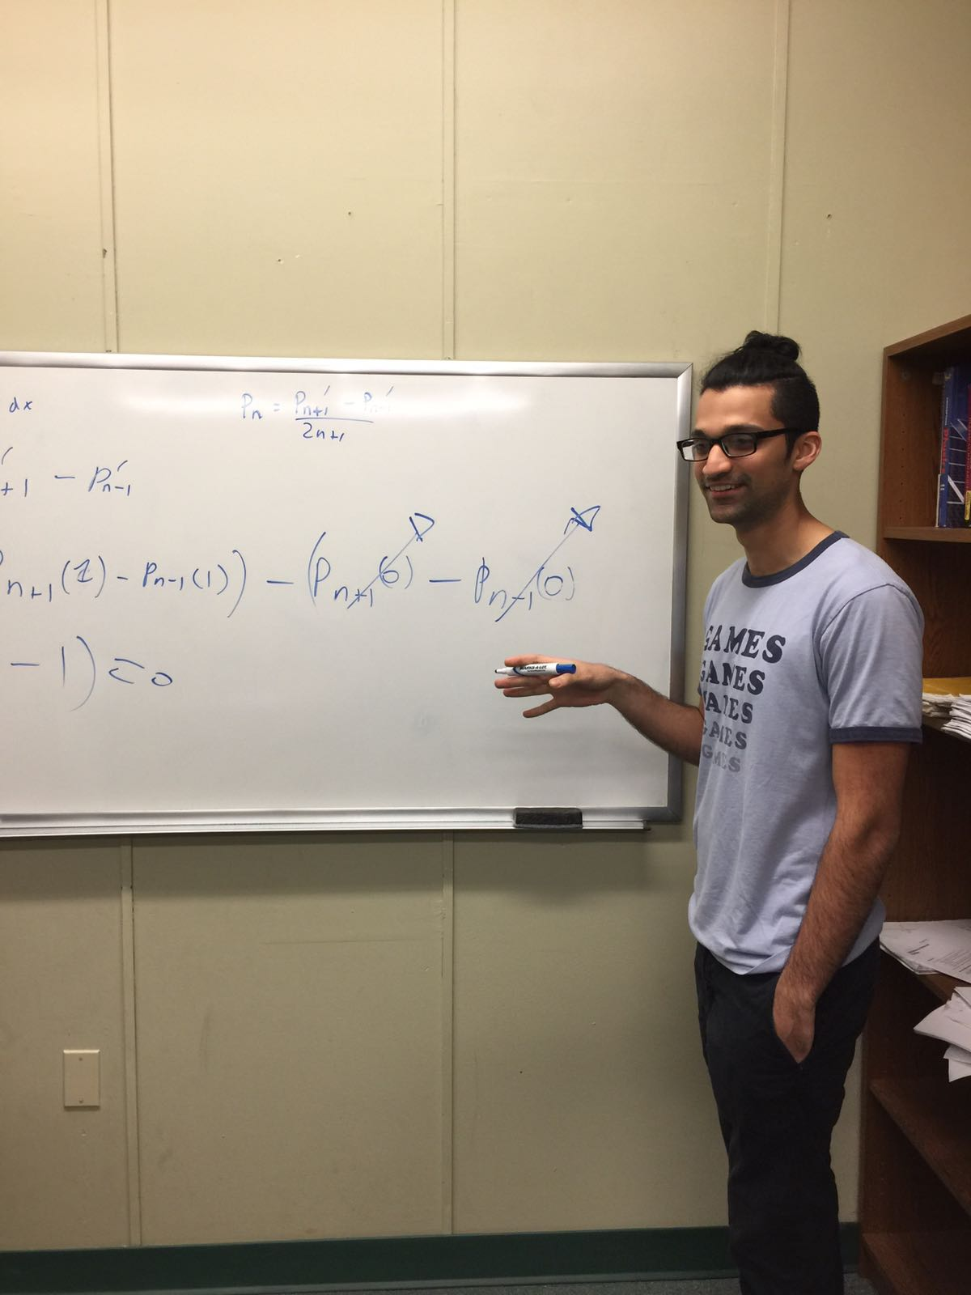
3SP Information Session Spring 2017
Neil Pandya
Adjunct Professor of Physics at Bergen Community College
Ph D Candidate and Research Assistant at Stevens Institute of Technology
E-mail: neil.pandya.np@gmail.com
Project topics of interest:
Mathematical and Theoretical Physics, Quantum Mechanics, Special Relativity, Pure Mathematics
Continuing Projects:
Special Relativity Diagrams (additions to Minkowski diagram)
Coherent Anti-stokes Raman Spectroscopy (CARS) project
Gambler’s fallacy research

Slide 35
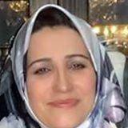
3SP Information Session Spring 2017
Dr. Farah Rezae
Professor of Chemistry
E-mail: frezae@bergen.edu
Project topics of interest:
Computers and Their Applications to Chemistry
Continuing Projects: Fold protein puzzles and contribute to critical scientific research.

Slide 36
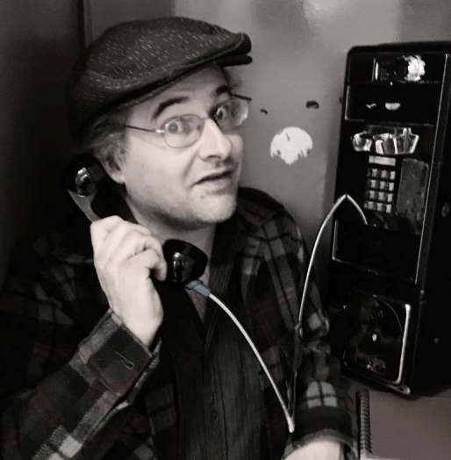
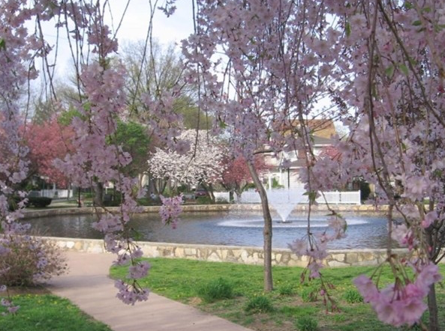
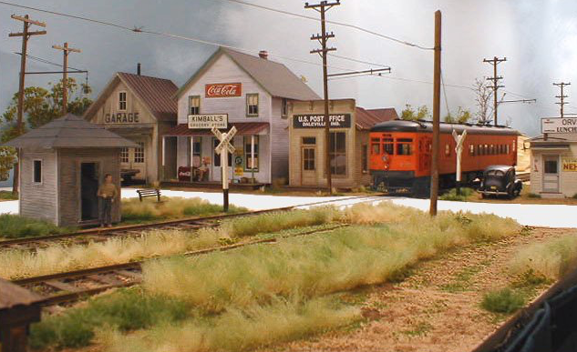
3SP Information Session Spring 2017
Dr. Charles Sontag
Professor of Biology
Office: S-235
E-mail:
csontag@bergen.edu
Project topics of interest:
Ecology, Environmental Science, Ethology, and Ferroequineology
Continuing Projects:
River Chemistry on the Hackensack River
Future and Potential Projects:
Eutrophication diagnosis in a small pond.
Tree Survey and labeling at Bergen Community College Campus.
Model Railroad Modules as a model for scale prototype construction and presentation of ideas and concepts.

Slide 37
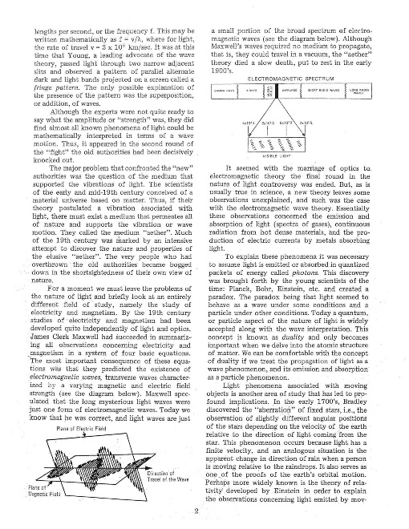
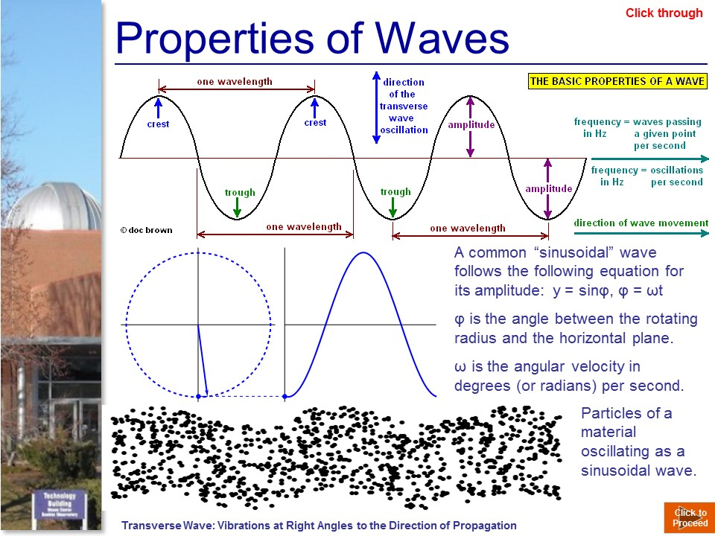
3SP Information Session Spring 2017
John M. Sanchez
Professor of Physics
E-mail: josanchez@bergen.edu
Project topics of interest:
Engineering, Energy-related projects, Astronomy, Nuclear Physics
Pedagogical Enhancement through Digital Multimedia
Continuing Projects:
Transformation of old paper based Astronomy Labs into Multimedia Intensive computer-enhanced learning and testing modules.

Slide 38
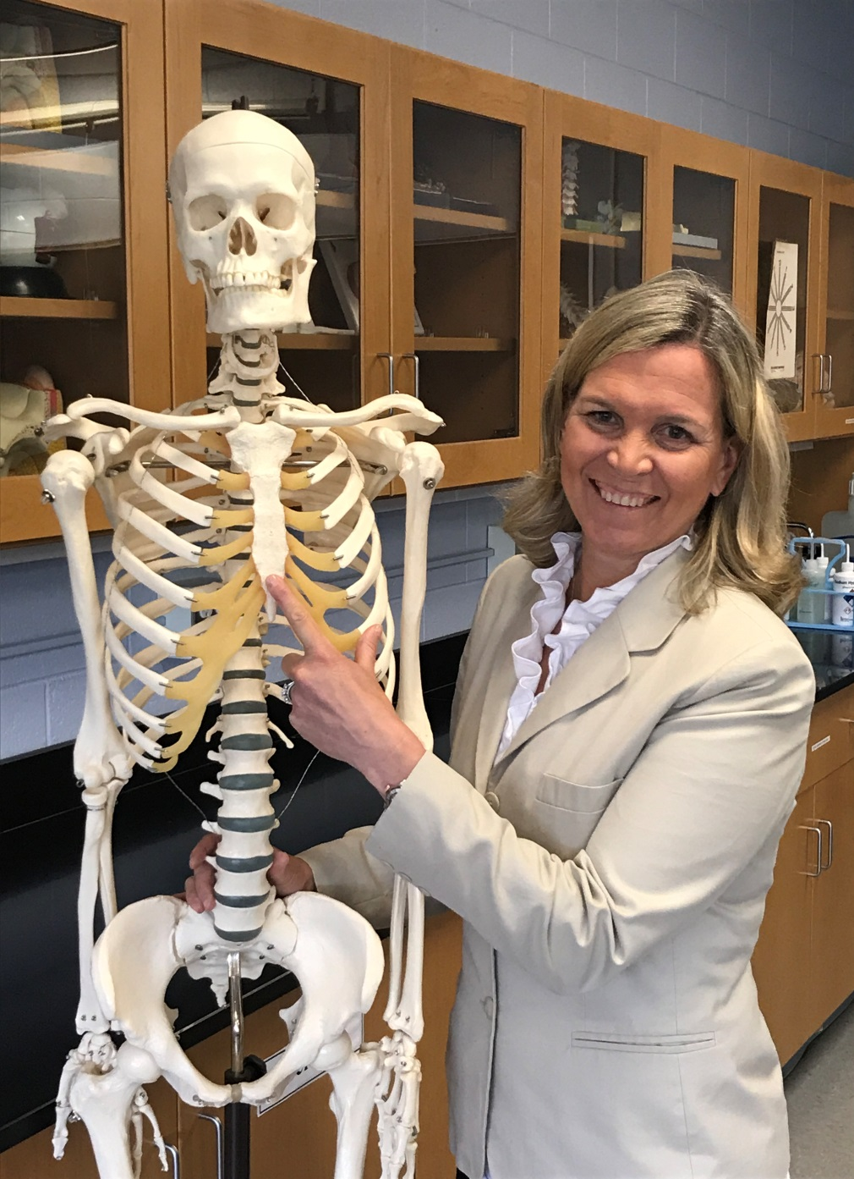
Dr. Coleen Coyle DiLauro Assistant Professor of Anatomy & Physiology Office S238 cdilauro@bergen.edu Project Topics of Interest: Brain Wave Analysis, Studies on Anxiety & Learning Styles, Brain Function & Neurology Continuing Projects: EEG: Neural Resonant Induction with a focus on Anxiety and Activated Brain Waves

Slide 39
Meet the 3SP Faculty Research Mentors!
Ron Grosinger- Alternative Fuel Education, Electric Car Conversion
Walter Rothaug – Astronomy, radio Astronomy, spectroscopic astronomy
Phil Dressner – computer Science, cybersecurity, Artificial intelligence
David Jacome – Physical Science, Plasma Physics

Slide 40
3SP Information Session Spring 2017
Questions and Comments?

